Slide 1

CSE4227 Digital Image Processing
_{Chapter 8 – Image Compression}
Dr. Kazi A Kalpoma
Professor, Department of CSE
Ahsanullah University of Science & Technology (AUST)
Contact: kalpoma@aust.edu
Google Class code: bux3jc2
CSE | AUST
Fall 2023

Slide 2
Today’s Contents
  Why do we need compression?
  Compression Ratio and Relative Data Redundancy
  How can we implement compression?
    Coding redundancy
    Spatial and temporal redundancy
    Irrelevant information
  Image Entropy
  Lossy and Loss-free Compression
  Different Compression Techniques
    Huffman coding
    Golomb coding
    Arithmetic coding
    LZW coding
    Run length coding
Chapter 8 from R.C. Gonzalez and R.E. Woods, Digital Image Processing (3rd Edition), Prentice Hall, 2008 [ Section 8.1, 8.2 ]
Notes:
kalpoma@gmail.com

Slide 3
Fundamentals
The term Data Compression refers to the process of reducing the amount of data required to represent a given quantity of information
Data and Information are not the same thing in image
Various amount of data can be used to represent the same information
Data might contain elements that provide irrelevant or repeated information : Data Redundancy
Data redundancy is a central issue in image compression.
It is not an abstract concept but mathematically quantifiable entity

Slide 4
Why do we need compression?
Data storage
Data transmission

Slide 5
Applications that require image compression are many and varied such as:
  Internet,
  Businesses,
  Multimedia,
  Satellite imaging,
  Medical imaging
  etc.

Slide 6
Why Images Are Compressed?
Let a SD TV 2-hour color sequence
  each of size 720X480
  frame rate: 30 frames/sec

Slide 7
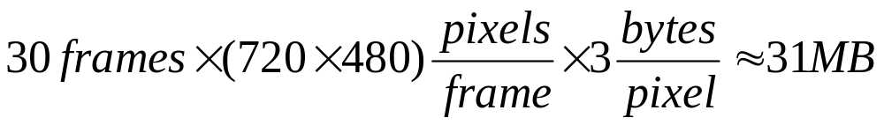
Why Images Are Compressed?
Let a SD TV 2-hour color sequence
  each of size 720X480
  frame rate: 30 frames/sec
For a single second, the amount of data to be accessed is

Slide 8
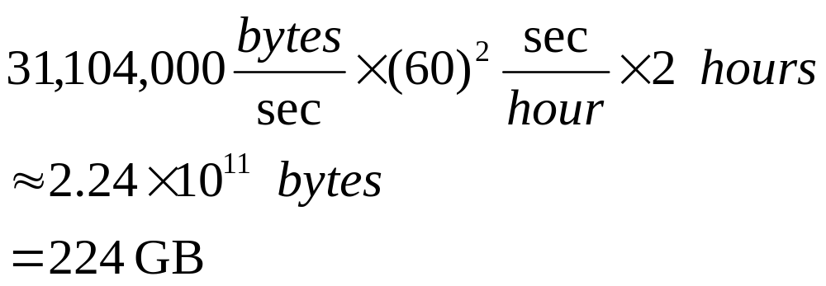
Why Images Are Compressed?
For a 2-hour long SD TV video, the data is
Twenty seven 8.5 GB dual-layer DVDs (12 cm disks) are needed to store it.
To put on a single DVD, must be compressed by a factor of 26.3

Slide 9
Why Images Are Compressed?
High Definition (HD) TV color sequence
  each of size 1920X1080 pixels
  Compression must be higher

Slide 10
Why Images Are Compressed?
High Definition (HD) TV color sequence
  each of size 1920X1080 pixels
  Compression must be higher
Web Images
  color images of size 128 X 128 through 56Kbps to 12Mbps connections
  Requires 7.0 to 0.03 seconds to download

Slide 11
Why Images Are Compressed?
High Definition (HD) TV color sequence
  each of size 1920X1080 pixels
  Compression must be higher
Web Images
  color images of size 128 X 128 through 56Kbps to 12Mbps connections
  Requires 7.0 to 0.03 seconds to download
1 GB Flash memory and 8 Megapixel Digital camera
  Can store at most ~41 uncompressed images

Slide 12
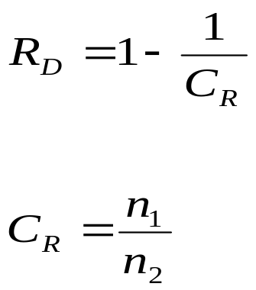
Data Redundancy
Let n₁ and n₂ denote the number of information carrying units in two data sets that represent the same information
The relative redundancy R_{D} is define as :
where C_{R}, commonly called the compression ratio, is
If n₁ = n_{2 ,} C_{R}=1 and R_{D}=0 no redundancy
If n₁ >> n_{2 ,} C_{R} → ∞ and R_{D} → 1 high redundancy
If n₁ << n_{2 ,} C_{R} → 0 and R_{D} → ∞ undesirable
A compression ration of 10 (10:1) means that the first data set has 10 information carrying units (say, bits) for every 1 unit in the second (compressed) data set.

Slide 13
How can we implement compression?
Coding redundancy
Most 2-D intensity arrays contain more bits than are needed to represent the intensities
Spatial and temporal redundancy
Pixels of most 2-D intensity arrays are correlated spatially and video sequences are temporally correlated
Irrelevant information
Most 2-D intensity arrays contain information that is ignored by the human visual system

Slide 14
Coding Redundancy
Code is system of symbols to represent info
Codeword or sequence of symbols represents a piece of info
The number of symbols required is its length
Try to minimize codeword length
Variable length Codeword representations for a piece of info

Slide 15
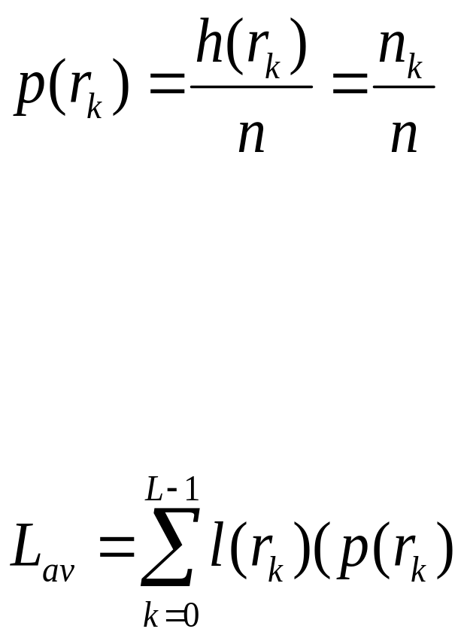
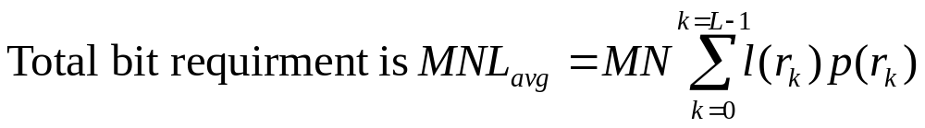
Optimal information Coding
Recall from the histogram calculations
where p(r_{k}) is the probability of a pixel to have a certain value r_{k}
If the number of bits used to represent r_{k} is l(r_{k}), then
average number of bits required to represent each pixel is

Slide 16

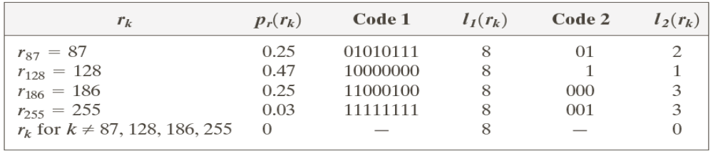
Coding Redundancy: Example
Total Bit required is
=256X256X8
Computer generated 256x256x8 bit image with coding redundancy

Slide 17
Coding Redundancy: Example
Total =256X256X1.81 bits
C =8/1.81=~4.42
R=1-1/C=.774
Computer generated 256x256x8 bit image with coding redundancy
77.4 %
L_{avg} =.25X2+.47X1+.25X3+.03X3=1.81 bits

Slide 18
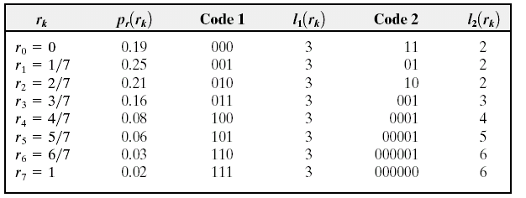
Coding Redundancy
Variable-Length Coding
2nd Example:
9.9% data redundant.

Slide 19
Spatial Redundancy
Intensities of each pixel may correlate to its neighbors
Many info is unnecessarily replicated
Try to minimize unnecessary data

Slide 20
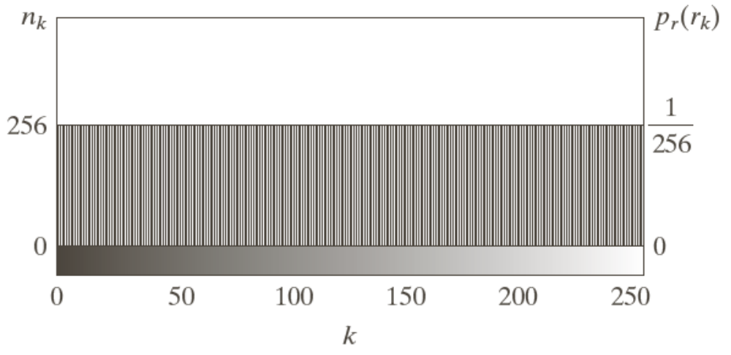
Spatial and Temporal Redundancy
Example
Computer generated 256x256x8 bit image with spatial redundancy
Histogram
Histogram is equiprobable
Vertically, pixels are independent
Horizontally, they are maximally correlated
The image cannot be compressed using variable length coding

Slide 21
Spatial and Temporal Redundancy
Example
Original Bit required
=256X256X8
In Run length
=(256+256)X8
C =(256X256X8)/(256+256)X8
=128:1
Computer generated 256x256x8 bit image with spatial redundancy
The image can be represented as a sequence of run length pair : intensity value and num of pixels with that intensity

Slide 22
Irrelevant Information
Many images has info that are ignored by the Human Visual System (HVS)
Try to remove these extraneous data

Slide 23
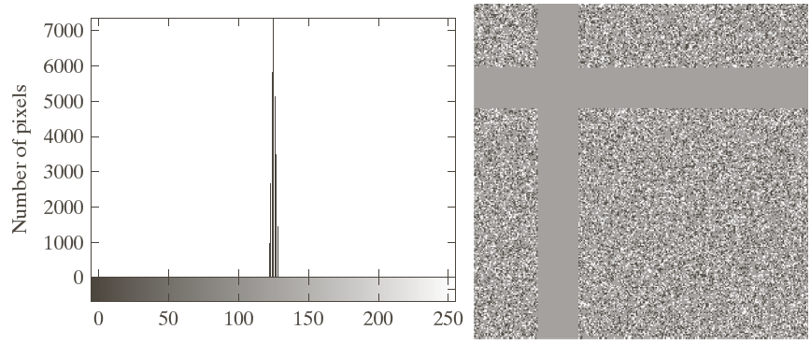
Irrelevant Information
Computer generated 256x256x8 bit image with irrelevant information
Can be represented using a single average gray level.
C =256X256X8:8
=65536:1

Slide 24
Irrelevant Information
Computer generated 256x256x8 bit image with irrelevant information
However, this coarse quantization may remove useful invisible information

Slide 25
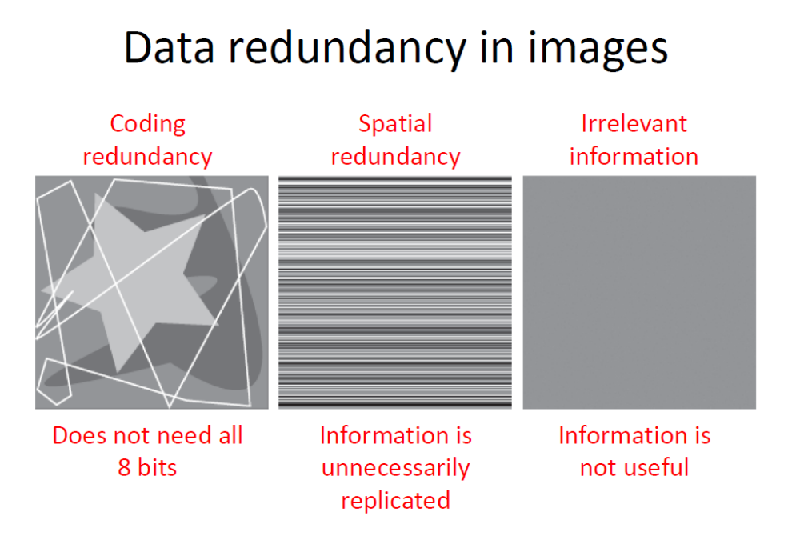

Slide 26
Redundancies We Tried to Remove
Coding redundancy
Spatial redundancy
Irrelevant information
How many bits do we really need to represent image-information?
Information theory: does it have any answer?

Slide 27
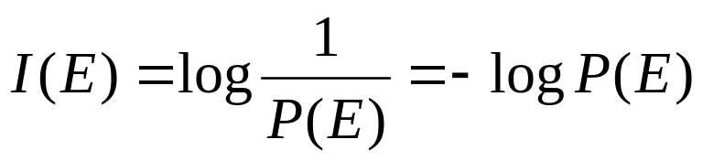
Measuring Image Information
Information Theory Review
A random event E with probability P(E) carries I(E) units of information,
Higher the uncertainty, higher the information content

Slide 28
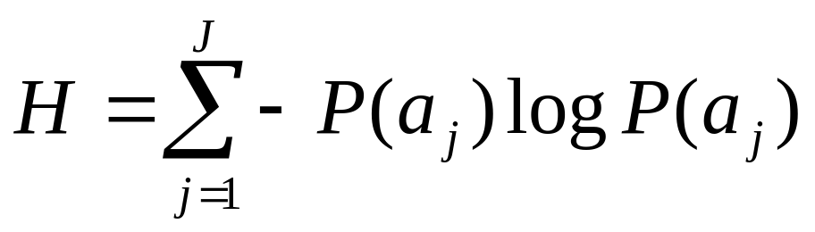
Information theory
If we have a source of random events from a discrete set of events {a₁, a₂, a₃,. . ., a_{J}} with probabilities, P(a₁), P(a₂), P(a₃),. . ., P(a_{J}) then the average information per event or the entropy of the source,

Slide 29
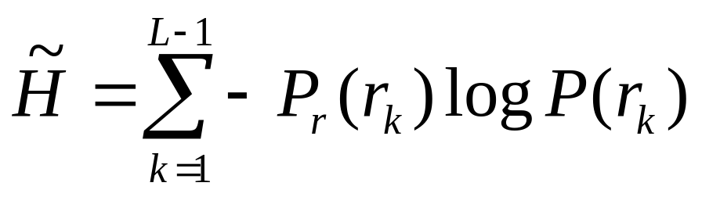
Calculating Image Entropy
If we consider the pixel intensities as random events, then the intensity histogram is the approximation of the probabilities
Entropy is the measurement of the average information in an image

Slide 30
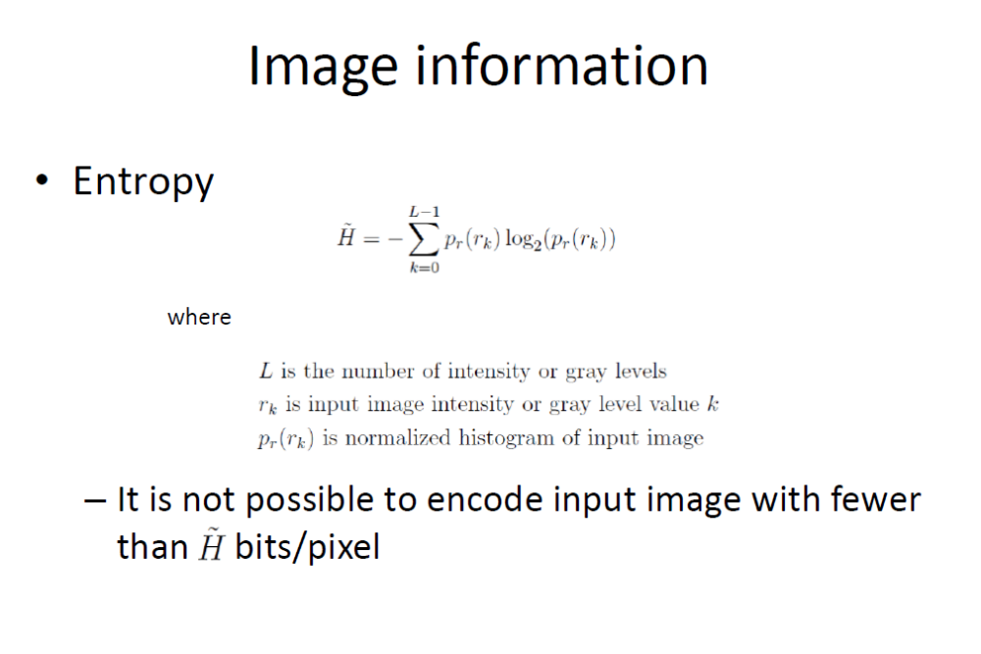

Slide 31
Image Entropy
Image entropy is a quantity which is used to describe the amount of information which must be coded for by a compression algorithm.
Low entropy images, such as those containing a lot of black sky, have very little contrast and large runs of pixels with the same or similar DN values.
An image that is perfectly flat will have an entropy of zero. Consequently, they can be compressed to a relatively small size.
On the other hand, high entropy images such as an image of heavily cratered areas on the moon have a great deal of contrast from one pixel to the next and consequently cannot be compressed as much as low entropy images.

Slide 32
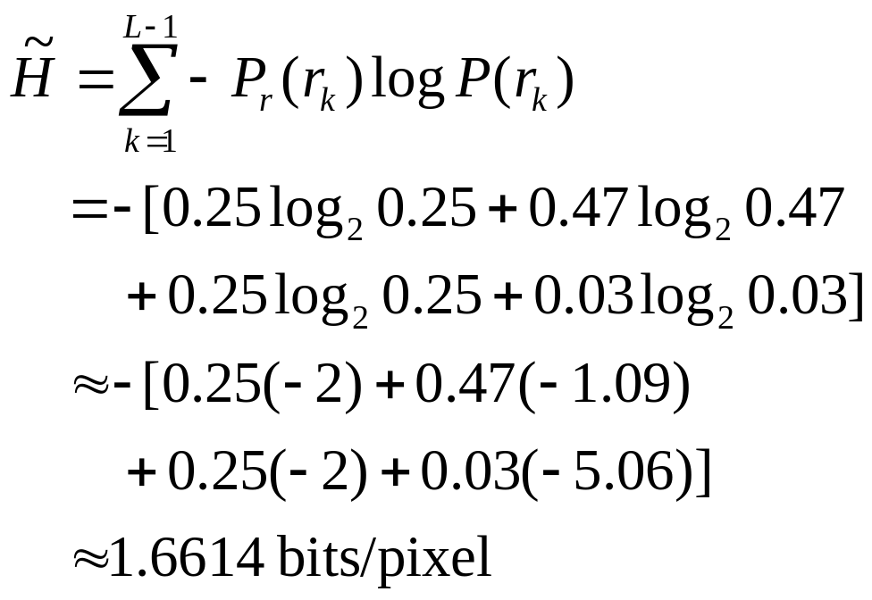
Image Entropy: Example
r_{k} P_{r}(r_{k})

Slide 33
Image Entropy: Example
H=1.6614
H=8
H=1.566
The amount of Entropy and thus information in an image is far from intuitive.

Slide 34
Image Entropy: Example
H=1.6614
H=8
H=1.566
Visual perception and entropy (information) are far from compliance

Slide 35
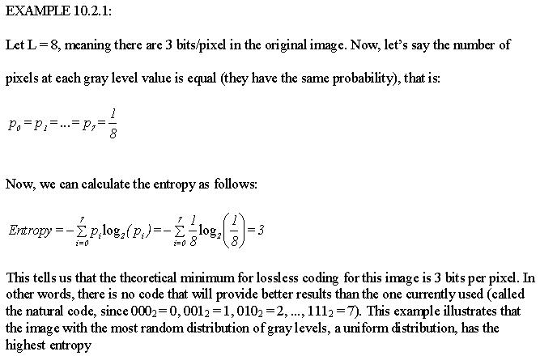
Entropy - Example

Slide 36
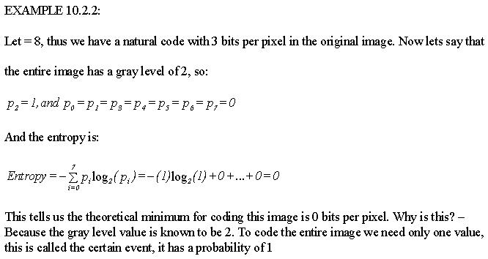
Entropy - Example

Slide 37
Compression Types
Compression
Error-Free Compression
(Loss-less)
Lossy Compression

Slide 38
Different Error Free Compression Techniques
Variable length coding
  Huffman coding
  Golomb coding
  Arithmetic coding
LZW coding
Bit plane coding
  Constant area coding
  Run length coding

Slide 39
Huffman Coding
The most popular technique for removing coding redundancy is due to Huffman (1952)
Huffman Coding yields the smallest number of code symbols per source symbol
The resulting code is optimal

Slide 40
Steps for Huffman Algorithm
The Huffman algorithm can be described in five steps:
Find the gray level probabilities for the image by finding the histogram
Order the input probabilities (histogram magnitudes) from largest to smallest
Combine the smallest two by addition
GOTO step 2, until only two probabilities are left
By working backward along the tree, generate code by alternating assignment of 0 and 1

Slide 41
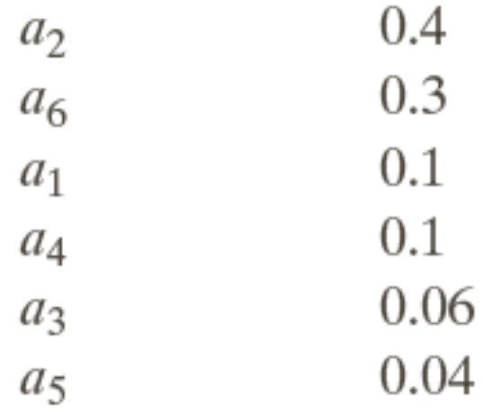
Huffman Coding: Example
Consider a 3 bit image with the following probabilities:
Source Symbol | Probability
 | 0.1
 | 0.4
 | 0.06
 | 0.1
 | 0.04
 | 0.3

Slide 42
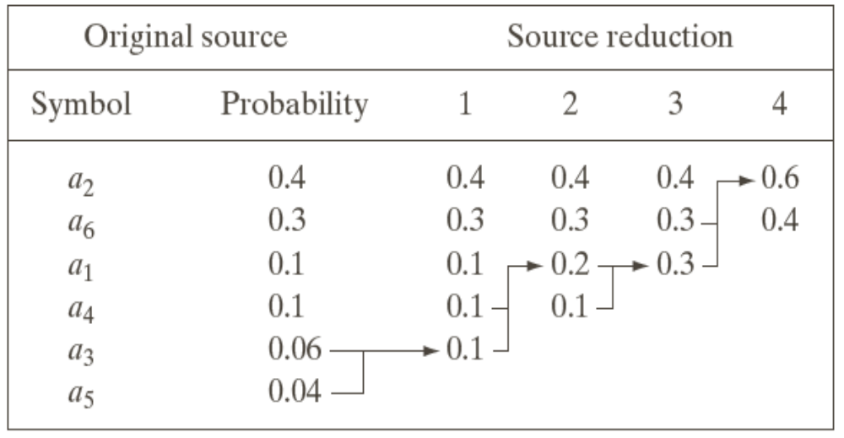
Huffman Coding: Example
Consider a 3 bit image with the following probabilities:

Slide 43
Huffman Coding: Example
Consider a 3 bit image with the following probabilities:

Slide 44
Huffman Coding: Example
Consider a 3 bit image with the following probabilities:
Source Reduction

Slide 45
Huffman Coding: Example
Consider a 3 bit image with the following probabilities:
Source Reduction

Slide 46
Huffman Coding: Example
Consider a 3 bit image with the following probabilities:

Slide 47
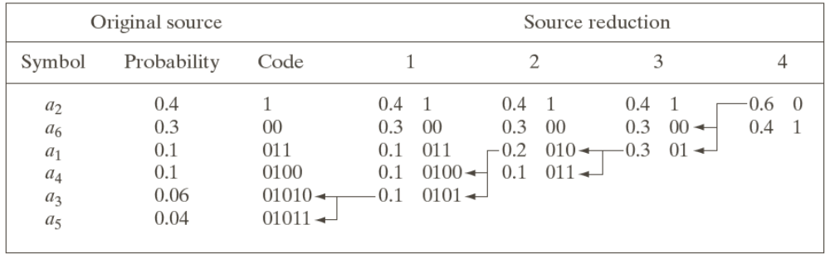
Huffman Coding: Example
Huffman Code assignment with 0 and 1:

Slide 48
Huffman Coding
Huffman Code assignment:

Slide 49
Huffman Coding
Huffman Code assignment:

Slide 50
Huffman Coding
Huffman Code assignment:

Slide 51
Huffman Coding
Huffman Code assignment:

Slide 52
Huffman Coding
0
1
0
1
0
1
0
1
0
1
Symbol Codeword
a₂ ₀
a₆ ₁₀
a₁ ₁₁₀
a₄ ₁₁₁₀
a₃ ₁₁₁₁₀
a₅ ₁₁₁₁₁

Slide 53
Huffman Coding Results
Avg. bit requirement/symbol:
H = -[(0.4)log₂(0.4)+(0.3)log₂(0.3)+(0.1)log₂(0.1)
+(0.1)log₂(0.1)+(0.06)log₂(0.06)+(0.04)log₂(0.04)
= 0.53+0.52+0.33+0.33+0.24+0.19
= 2.14 bits/pixel
C = 3/2.2 = 1.364
R_{D} = (1- 1/1.364) = 0.267
Log₂(x) = log₁₀(x)x3.322

Slide 54
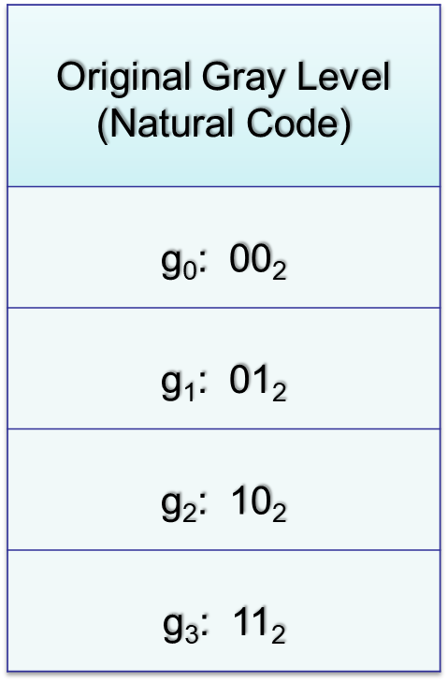
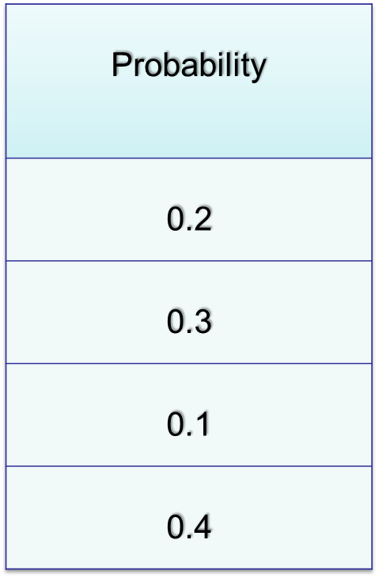
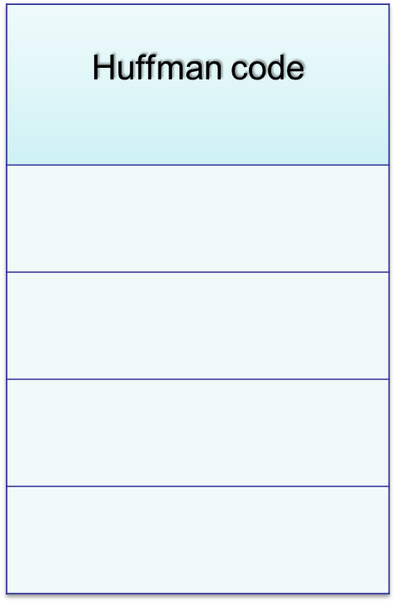
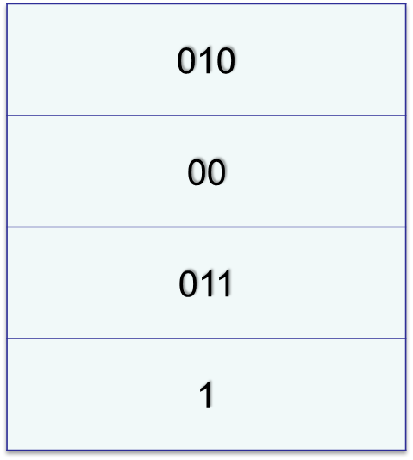
Huffman Coding Example 2
More frequently occurring fewer bits for the code
Notes:
Table 10-1

Slide 55
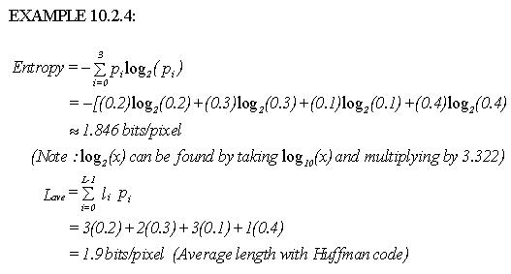
Huffman Coding Example – Entropy vs. Ave bpp
Example 2:

Slide 56
Huffman Coding Example – Results
In the example, we observe a 2.0 : 1.9 compression, which is about a 1.05 compression ratio, providing about 5% redundant data compression.
From the examples, we can see that the Huffman code is highly dependent on the histogram, so any preprocessing to simplify the histogram will help improve the compression ratio

Slide 57
Huffman Coding
Properties :
codes one symbol at a time
Block code
  each symbol is mapped to a block of code
Instantaneously decodable
  does not need to foresee the future codes while decoding
Uniquely decodable
  any string of code symbol can be decoded in only one way

Slide 58
Golomb Coding
The Golomb code of n with respect to m, denoted G_{m}(n),
is a combination of the unary code of quotient, floor[n/m]
and the binary representation of reminder (n mod m).
Can only be used to represent nonnegative integers inputs
with exponentially decaying probability distributions
can be optimally encoded
using a family of codes.
Computationally simpler than Huffman codes.

Slide 59
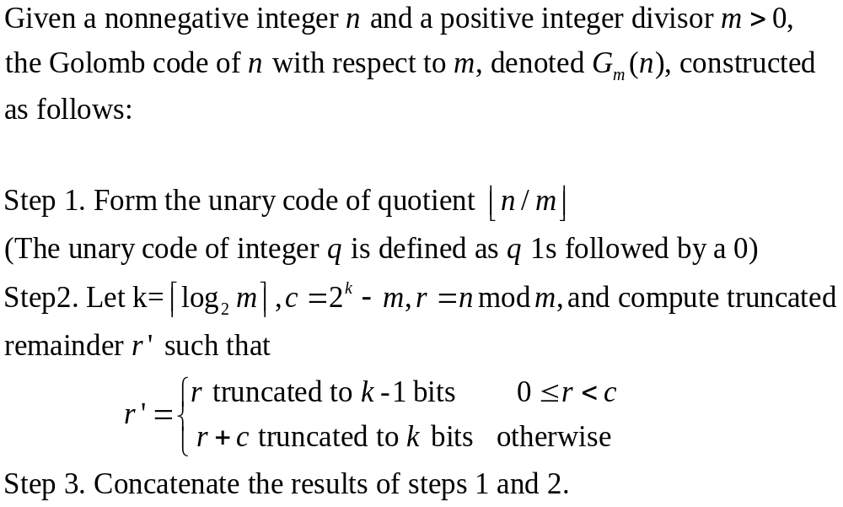
Some Basic Compression Methods:
Golomb Coding

Slide 60
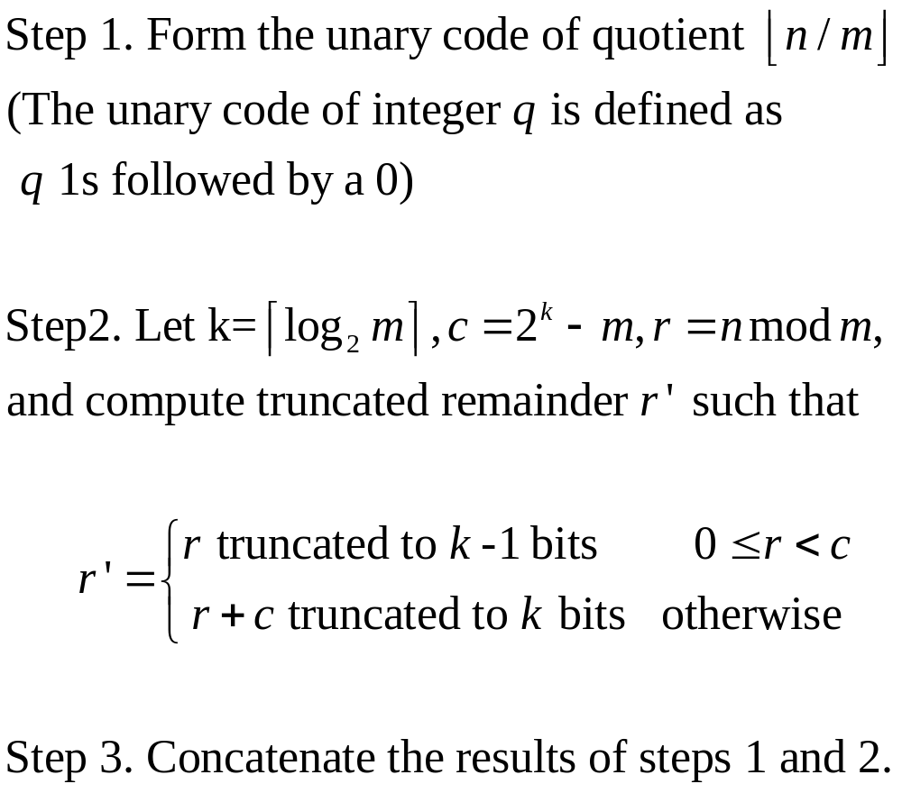
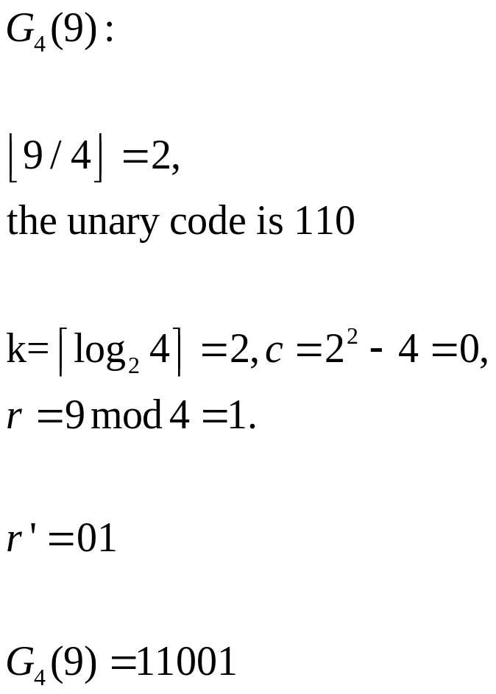
Some Basic Compression Methods:
Golomb Coding

Slide 61

Some Basic Compression Methods:
Golomb Coding

Slide 62
Golomb Coding
Fill the chart at home
n | G₁(n) | G₂(n) | G₄(n)
0
1
2
3
4
5
6
7 | 11111110 | 11101 | 1011

Slide 63
Loss Less Compression: Arithmetic Coding:
Variable length code
Error-free compression technique
Non block coding
  one to one correspondence between symbol and code does not exist
  An entire sequence of source symbols (string of symbol) is mapped to a single arithmetic number (code word)
  The code word itself defines an interval of real numbers between 0 and 1.
This coding can achieve theoretically higher compression rates than Huffman codes

Slide 64
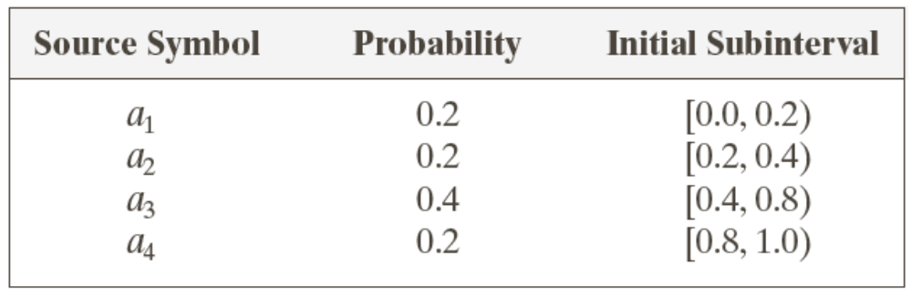
Arithmetic Coding
Maintains an interval between [0 1] based on the probabilities of the symbol
A four symbol source

Slide 65
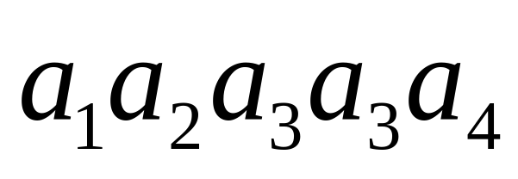
Arithmetic Coding
Let we have a symbol sequence or message of a four symbol source
need to code the sequence with Arithmetic coding.

Slide 66
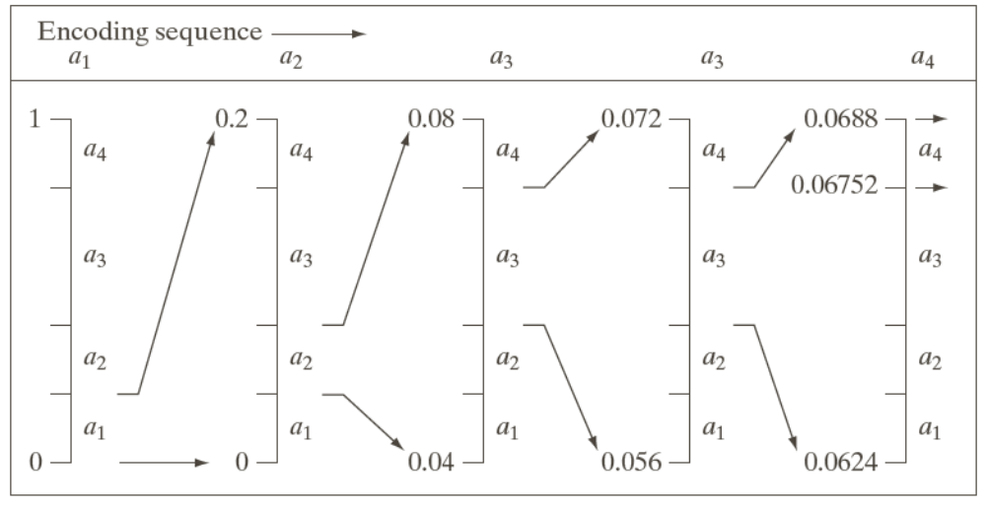
Arithmetic Coding
At the start, interval [0,1) is subdivided initially into four regions based on the probabilities

Slide 67
Arithmetic Coding
Symbol a₁, associated with subinterval [0,0.2) is the first message being coded and expanded the full height in narrow range

Slide 68
Arithmetic Coding
Symbol a₁, associated with subinterval [0,0.2) is the first message being coded and expanded the full height in narrow range
0.16
0.08
0.04

Slide 69
Arithmetic Coding
Symbol a₂, associated with subinterval [0.04, 0.08) is expanded the full height in narrow range again
0.16
0.08
0.04

Slide 70
Arithmetic Coding
Symbol a₂, associated with subinterval [0.04, 0.08) is expanded the full height in narrow range again
0.16
0.072
0.08
0.056
0.04
0.048

Slide 71
Arithmetic Coding
Symbol a₃, associated with subinterval [0.056, 0.072) is expanded the full height in narrow range again
0.16
0.072
0.08
0.056
0.04
0.048

Slide 72
Arithmetic Coding
Symbol a₃, associated with subinterval [0.056, 0.072) is expanded the full height in narrow range again
0.16
0.072
0.0688
0.08
0.056
0.0624
0.04
0.048
0.0592

Slide 73
Arithmetic Coding
Now symbol a₃, associated with subinterval [0.064, 0.0688) is expanded the full height in narrow range again
0.16
0.072
0.0688
0.08
0.056
0.0624
0.04
0.048
0.0592

Slide 74
Arithmetic Coding
Now symbol a₄, associated with subinterval [0.06752, 0.0688) is expanded the full height in narrow final range. Any number within this range can be use as message. Example: 0.068
0.16
0.072
0.0688
0.08
0.056
0.0624
0.04
0.048
0.0592

Slide 75
Arithmetic Coding
The arithmetic code for the sequence
is 0.068
How to Decode it?

Slide 76
Decoding
0.068

Slide 77
Decoding
0.068

Slide 78
Decoding
0.068
0.16
0.08
0.04

Slide 79
Decoding
0.068
0.16
0.08
0.04

Slide 80
Decoding
0.068
0.16
0.072
0.08
0.056
0.04
0.048

Slide 81
Decoding
0.068
0.16
0.072
0.08
0.056
0.04
0.048

Slide 82
Decoding
0.068
0.16
0.072
0.0688
0.08
0.056
0.0624
0.04
0.048
0.0592

Slide 83
Decoding
0.068
0.16
0.072
0.0688
0.08
0.056
0.0624
0.04
0.048
0.0592

Slide 84
Decoding
0.068
0.16
0.072
0.0688
0.08
0.056
0.0624
0.04
0.048
0.0592

Slide 85
Lempel-Ziv-Welch (LZW) Coding
An error-free compression technique
Removes spatial redundancy
Assign fixed-length code words to variable length sequences of source symbols
It does not require any knowledge of probability of occurrence
LZW coding is used in the GIF, TIFF and PDF formats

Slide 86
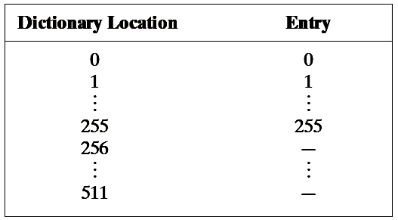
LZW Encoding – Images
Images are scanned from left to right and from top to bottom
A codebook or dictionary containing the source symbols to be coded is constructed on the fly
For 8-bit monochrome images, first 256 words of the dictionary are assigned to intensities 0,1,2,3,…,255.

Slide 87
Lempel-Ziv-Welch (LZW) Coding
Coding Technique
Generate a codebook/dictionary
  first 256 entries are assigned to gray levels 0,1,2,..,255.
  New gray level sequences not already in the dictionary are assigned to a new entry.
  Example: for sequence “255-255” can be assigned to entry# 256, the address following the locations reserved for gray levels 0 to 255.

Slide 88
LZW Encoding – Images
The next time that two consecutive white pixels are encountered, codeword 256 (the address of the location containing 255-255) is used to represent them
If 9-bit, 512-word dictionary is employed then two pixels (16 bits) can be represented by 9 bits only

Slide 89
Lempel-Ziv-Welch (LZW) Coding
Example
Consider the following 4 x 4 8 bit image
39 39 126 126
39 39 126 126
39 39 126 126
39 39 126 126
Dictionary Location Entry
0 0
1 1
. .
255 255
256 -
511 -
Initial Dictionary

Slide 90
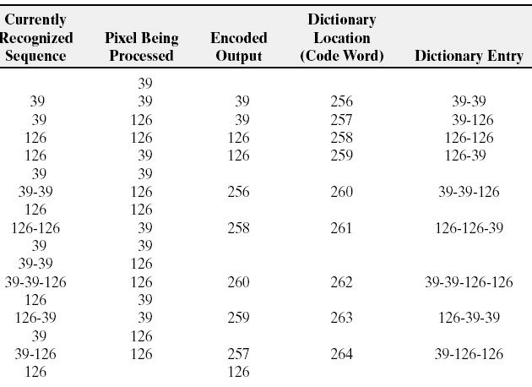
Lempel-Ziv-Welch (LZW) Coding
39 39 126 126
39 39 126 126
39 39 126 126
39 39 126 126
Dictionary Entry
Location
0 0
1 1
. .
255 255
256 -
511 -
Sequence= Concatenate(‘ ’, ‘39’) = 39

Slide 91
Lempel-Ziv-Welch (LZW) Coding
39 39 126 126
39 39 126 126
39 39 126 126
39 39 126 126
Dictionary Entry
Location
0 0
1 1
. .
255 255
256 -
511 -
Sequence= Concatenate(‘ ’, ‘39’) = 39

Slide 92
Lempel-Ziv-Welch (LZW) Coding
39 39 126 126
39 39 126 126
39 39 126 126
39 39 126 126
Dictionary Entry
Location
0 0
1 1
. .
255 255
256 -
511 -
Sequence= Concatenate(‘39’, ‘39’) = 39-39

Slide 93
Lempel-Ziv-Welch (LZW) Coding
39 39 126 126
39 39 126 126
39 39 126 126
39 39 126 126
Dictionary Entry
Location
Address of ‘39’
0 0
1 1
. .
255 255
256 39-39
511 -
Sequence= Concatenate(‘39’, ‘39’) = 39-39

Slide 94
Lempel-Ziv-Welch (LZW) Coding
39 39 126 126
39 39 126 126
39 39 126 126
39 39 126 126
Dictionary Entry
Location
0 0
1 1
. .
255 255
256 39-39
511 -

Slide 95
Lempel-Ziv-Welch (LZW) Coding
39 39 126 126
39 39 126 126
39 39 126 126
39 39 126 126
Dictionary Entry
Location
0 0
1 1
. .
255 255
256 39-39
511 -
Sequence= Concatenate(‘39’, ‘126’) = 39-126

Slide 96
Lempel-Ziv-Welch (LZW) Coding
39 39 126 126
39 39 126 126
39 39 126 126
39 39 126 126
Dictionary Entry
Location
Address of ‘39’
0 0
1 1
. .
255 255
256 39-39
511 -
Sequence= Concatenate(‘39’, ‘126’) = 39-126

Slide 97
Lempel-Ziv-Welch (LZW) Coding
39 39 126 126
39 39 126 126
39 39 126 126
39 39 126 126
Dictionary Entry
Location
0 0
1 1
. .
255 255
256 39-39
511 -
Sequence= Concatenate(‘39’, ‘126’) = 39-126

Slide 98
Lempel-Ziv-Welch (LZW) Coding
39 39 126 126
39 39 126 126
39 39 126 126
39 39 126 126
Dictionary Entry
Location
0 0
1 1
. .
255 255
256 39-39
511 -
Sequence= Concatenate(‘126’, ‘126’) = 126-126

Slide 99
Lempel-Ziv-Welch (LZW) Coding
39 39 126 126
39 39 126 126
39 39 126 126
39 39 126 126
Dictionary Entry
Location
0 0
1 1
. .
255 255
256 39-39
511 -
Sequence= Concatenate(‘126’, ‘39’) = 126-39

Slide 100
Lempel-Ziv-Welch (LZW) Coding
39 39 126 126
39 39 126 126
39 39 126 126
39 39 126 126
Dictionary Entry
Location
0 0
1 1
. .
255 255
256 39-39
511 -
Sequence= Concatenate(‘39’, ‘39’) = 39-39

Slide 101
Lempel-Ziv-Welch (LZW) Coding
39 39 126 126
39 39 126 126
39 39 126 126
39 39 126 126
Dictionary Entry
Location
0 0
1 1
. .
255 255
256 39-39
511 -
Sequence= Concatenate(‘39’, ‘39’) = 39-39

Slide 102
Lempel-Ziv-Welch (LZW) Coding
39 39 126 126
39 39 126 126
39 39 126 126
39 39 126 126
Dictionary Entry
Location
0 0
1 1
. .
255 255
256 39-39
511 -
Sequence= Concatenate(‘39’, ‘39’) = 39-39

Slide 103
Lempel-Ziv-Welch (LZW) Coding
39 39 126 126
39 39 126 126
39 39 126 126
39 39 126 126
Dictionary Entry
Location
0 0
1 1
. .
255 255
256 39-39
511 -
Sequence= Concatenate(’39-39’, ‘126’) = 39-39-126

Slide 104
Lempel-Ziv-Welch (LZW) Coding
39 39 126 126
39 39 126 126
39 39 126 126
39 39 126 126
Dictionary Entry
Location
0 0
1 1
. .
255 255
256 39-39
511 -
Sequence= Concatenate(’126’, ‘126’) = 126-126

Slide 105
Lempel-Ziv-Welch (LZW) Coding
39 39 126 126
39 39 126 126
39 39 126 126
39 39 126 126
Dictionary Entry
Location
0 0
1 1
. .
255 255
256 39-39
511 -
Sequence= Concatenate(’126-126’, ‘39’) = 126-126-39

Slide 106
Lempel-Ziv-Welch (LZW) Coding
39 39 126 126
39 39 126 126
39 39 126 126
39 39 126 126
Dictionary Entry
Location
0 0
1 1
. .
255 255
256 39-39
511 -

Slide 107
Lempel-Ziv-Welch (LZW) Coding
Encoding of
39 39 126 126
39 39 126 126
39 39 126 126
39 39 126 126
is
39 39 126 126
256 258 260 259 257 126
How to decode?

Slide 108
LZW Decoding
Dictionary Code word | Dictionary entry
0 | 0
1 | 1
| | |
39 | 39
| | |
126 | 126
| | |
255 | 255
256 | 39-39
257 | 39-126
258 | 126-126
259 | 126-39
260 | 39-39-126
261 | 126-126-39
262 | 39-39-126-126
263 | 126-39-39
264 | 39-126-126
Decoding of
39 39 126 126 256 258 260 259 257 126
is
39

Slide 109
LZW Decoding
Dictionary Code word | Dictionary entry
0 | 0
1 | 1
| | |
39 | 39
| | |
126 | 126
| | |
255 | 255
256 | 39-39
257 | 39-126
258 | 126-126
259 | 126-39
260 | 39-39-126
261 | 126-126-39
262 | 39-39-126-126
263 | 126-39-39
264 | 39-126-126
Decoding of
is
39 39

Slide 110
LZW Decoding
Dictionary Code word | Dictionary entry
0 | 0
1 | 1
| | |
39 | 39
| | |
126 | 126
| | |
255 | 255
256 | 39-39
257 | 39-126
258 | 126-126
259 | 126-39
260 | 39-39-126
261 | 126-126-39
262 | 39-39-126-126
263 | 126-39-39
264 | 39-126-126
Decoding of
is
39 39 126

Slide 111
LZW Decoding
Dictionary Code word | Dictionary entry
0 | 0
1 | 1
| | |
39 | 39
| | |
126 | 126
| | |
255 | 255
256 | 39-39
257 | 39-126
258 | 126-126
259 | 126-39
260 | 39-39-126
261 | 126-126-39
262 | 39-39-126-126
263 | 126-39-39
264 | 39-126-126
Decoding of
is
39 39 126 126

Slide 112
LZW Decoding
Dictionary Code word | Dictionary entry
0 | 0
1 | 1
| | |
39 | 39
| | |
126 | 126
| | |
255 | 255
256 | 39-39
257 | 39-126
258 | 126-126
259 | 126-39
260 | 39-39-126
261 | 126-126-39
262 | 39-39-126-126
263 | 126-39-39
264 | 39-126-126
Decoding of
is
39 126 126
39 39

Slide 113
LZW Decoding
Dictionary Code word | Dictionary entry
0 | 0
1 | 1
| | |
39 | 39
| | |
126 | 126
| | |
255 | 255
256 | 39-39
257 | 39-126
258 | 126-126
259 | 126-39
260 | 39-39-126
261 | 126-126-39
262 | 39-39-126-126
263 | 126-39-39
264 | 39-126-126
Decoding of
is
39 126 126
39 39 126 126

Slide 114
LZW Decoding
Dictionary Code word | Dictionary entry
0 | 0
1 | 1
| | |
39 | 39
| | |
126 | 126
| | |
255 | 255
256 | 39-39
257 | 39-126
258 | 126-126
259 | 126-39
260 | 39-39-126
261 | 126-126-39
262 | 39-39-126-126
263 | 126-39-39
264 | 39-126-126
Decoding of
is
39 126 126
39 39 126 126
39 39 126

Slide 115
LZW Decoding
Dictionary Code word | Dictionary entry
0 | 0
1 | 1
| | |
39 | 39
| | |
126 | 126
| | |
255 | 255
256 | 39-39
257 | 39-126
258 | 126-126
259 | 126-39
260 | 39-39-126
261 | 126-126-39
262 | 39-39-126-126
263 | 126-39-39
264 | 39-126-126
Decoding of
is
39 126 126
39 39 126 126
39 39 126 126
39

Slide 116
LZW Decoding
Dictionary Code word | Dictionary entry
0 | 0
1 | 1
| | |
39 | 39
| | |
126 | 126
| | |
255 | 255
256 | 39-39
257 | 39-126
258 | 126-126
259 | 126-39
260 | 39-39-126
261 | 126-126-39
262 | 39-39-126-126
263 | 126-39-39
264 | 39-126-126
Decoding of
is
39 126 126
39 39 126 126
39 39 126 126
39 39 126

Slide 117
LZW Decoding
Dictionary Code word | Dictionary entry
0 | 0
1 | 1
| | |
39 | 39
| | |
126 | 126
| | |
255 | 255
256 | 39-39
257 | 39-126
258 | 126-126
259 | 126-39
260 | 39-39-126
261 | 126-126-39
262 | 39-39-126-126
263 | 126-39-39
264 | 39-126-126
Decoding of
is
39 126 126
39 39 126 126
39 39 126 126
39 39 126 126

Slide 118
Compression Ratio using LZW Coding
Suppose sequence 39-39-126 is replaced by 260
In other words 3X8=24 bits are replaced by 9 bits
Original image = 16X8 bits = 128 bits
Compressed Image = 10X9 bits = 90 bits
Compression Ratio = 128:90 = 1.42:1

Slide 119
Run Length Encoding
Recall
Image features
  All 256 gray levels are equally probable → uniform histogram
  (variable length coding can not be applied)
  The gray levels of each line are selected randomly so pixels are independent of one another in vertical direction
  Pixels along each line are identical, they are completely dependent on one another in horizontal direction
A computer generated (synthetic) 8-bit image
M = N = 256
Spatial redundancy

Slide 120
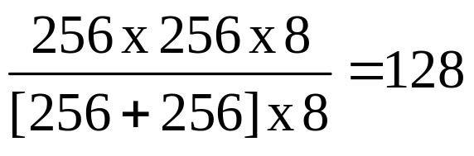
Run Length Encoding
Recall
The spatial redundancy can be eliminated by using run-length pairs (a mapping scheme)
Run length pairs has two parts
  Start of new intensity
  Number of consecutive pixels having that intensity
Example (consider the image shown in previous slide)
  Each 256 pixel line of the original image is replaced by a single 8-bit intensity value
  Length of consecutive pixels having the same intensity = 256
  Compression Ratio =

Slide 121
Run Length Encoding (RLC)
1b 2w 1b 3w 4b 1w
Uses run length pairs
  (0, 1), (1, 2), (0, 1), (1, 3), …
Eliminates small spatial redundancies
However, small runs results in expansion instead of compression

Slide 122
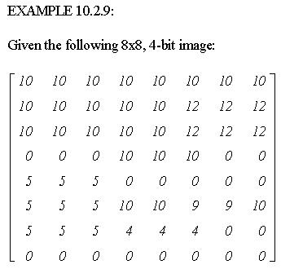

Slide 123
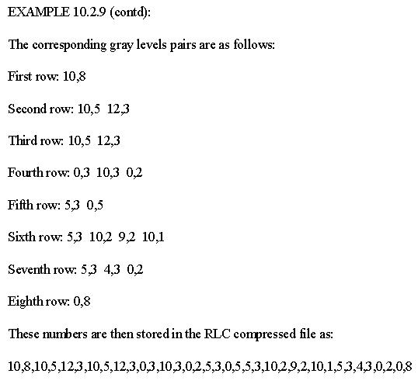

Slide 124
Run Length Encoding (RLC)
Original image = 64X4 bits = 256 bits
Compressed Image = 36X4 bits = 144 bits
Compression Ratio = 64:36 = 16:9

Slide 125
Run Length Encoding (RLE) in
Binary Image
Run-length Encoding is also effective in case of binary images
can be represented as a sequence of runs only
  Example:
  Its representation: 121341
Fix a way to determine the run values:
  Specify the value of first run
  Assume each row begins with a white run!!
1b 2w 1b 3w 4b 1w

Slide 126
RLE – Binary Images
Adjacent pixels in binary images are more likely to be identical
  Scan an image row from left to right and code each contiguous group (i.e. run) of 0s or 1s according to its length
  Establish a convention to determine the value of the run
Common conventions are
  To specify the value of the first run of each row
  To assume that each row begins with a white run, whose run length may in fact be zero

Slide 127
RLE – Binary Images
Example:
Specify the value of the first run of each row:
  0 5 2 5 1 8 1 1 2 5: gray level of the first run is ‘0’ (black)
Assume each row begins with a white run (bit ‘1’):
  0 5 2 5 1 8 1 1 2 5: length of the first (white) run is 0
000001100000100000000101100000 (30 bits in a row)

Slide 128
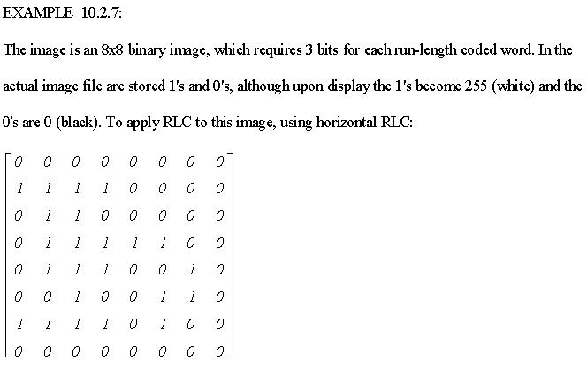
Use the convention that the first number corresponds to the number of zeros (black) in a run

Slide 129
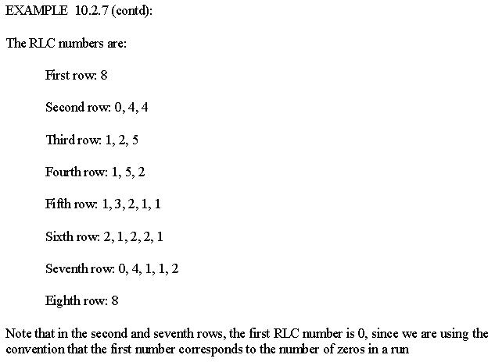

Slide 130
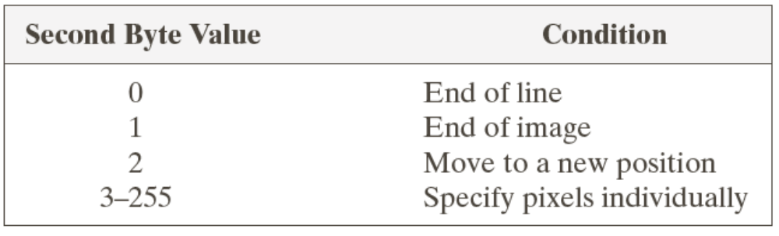
Run Length Encoding in BMP
Uses a combination of encoded and absolute mode
Either mode can appear anywhere in the image
Encoded mode:
  2 byte RLC
  First byte: run length --Second byte: gray/color index
Absolute mode:
  2 byte RLC
  First byte: 0 --Second byte: as follows

